Slide 1
Majlis Ansarullah
Monthly Meeting
Nov 2016
This slide deck contains images licensed for the purpose of this presentation only.
No one is permitted to use the images for any other use, without prior permission.

Slide 2
AGENDA
Recitation of the Holy Qur’an (2:222)
Pledge
Reminders: Recitation of the Holy Qur’an and Congregational Prayers
Monthly topic: Encouraging our children to marry early and choose right partners
Health topic: Oral and Dental Health
National Reminders/Announcements
Local Reminders/Announcements
Dua

Slide 3
Why read the Holy Qur’an regularly?
HOLY Qur’an IS A PRECIOUS BLESSINGS AND A GREAT TREASURE
Without the Holy Qur’an the whole world would have been no better than a dirty clot of half formed flesh. Indeed it is book as compared to which all other scriptures and sources of guidance amount to nothing at all. The Holy Qur’an can purify man within a week, provided there is no attempt to get away from it in form and spirit. The Qur’an can make you like the prophets, provided you do not try yourself to run away from it.
Our Teaching, Page 26

Slide 4
Watching Our Congregational Salat!
Rows of Angels
And the Prophet (SAW) also said: “The rows of congregational prayer are like rows of angels on the fourth level of heaven.”
(Al Bukhari)

Slide 5
Encouraging our children to marry early and help them choose right partners?

Slide 6

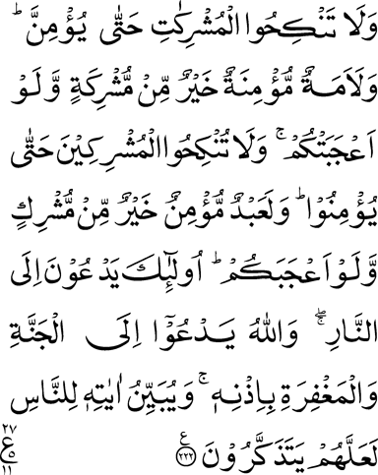
Click to listen the recitation
[2:222] And marry not idolatrous women until they believe; even a believing bond-woman is better than an idolatress, although she may highly please you. And give not believing women in marriage to idolaters until they believe; even a believing slave is better than an idolater, although he may highly please you. These call to the Fire, but Allah calls to Heaven and to forgiveness by His command. And He makes His Signs clear to the people that they may remember.

Slide 7
This verse prohibits Muslim men and women to marry idolaters. What is the wisdom behind it?
Share your thoughts

Slide 8
The prohibition is based on religious as well as moral and social grounds. An idolatrous husband is bound to exercise an extremely baneful influence not only on his wife but on his children as well; whereas an idolatrous wife is sure to ruin the early training of the offspring. Moreover, when a believing man has an idolatrous wife or vice versa, their ideas, beliefs, culture and outlook on life being widely different, there cannot possibly be harmony or concord between the two and their life is sure to become miserable, if they possess any attachment whatever for their religion.
(Five Volume Commentary, pages 289-290)

Slide 9
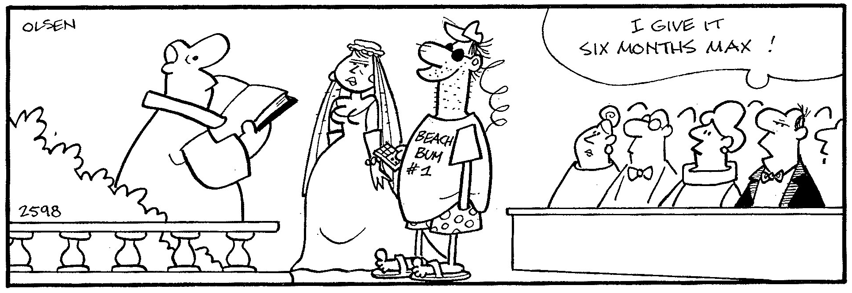
Discussion I
Parents of a of 24-years- old girl who is about to finish her Masters degree are trying to find a good match for her. The girl wants to marry her cousin who is a car mechanic. Mother is ok with her choice but father disagrees saying, “I will never marry my educated daughter to a car mechanic.” Mother’s argument is that they have seen the boy grow up in front of their eyes, and that he is well connected with the Jama’at. The father continues to show reluctance. What should they do?

Slide 10
  Option 1: They should respect their daughter’s choice and marry her with her cousin.
  Option 2: They should tell their daughter that they will find a better and more educated match for her.
  Option 3: They should tell their daughter unless her cousin starts his own business earning a better living, they will not agree to the marriage.
Option 4: Any other response?
Notes:
To what extent will you go to offer salat in congregation?

Slide 11
Guidance from the Holy Prophet (saw)
Abu Hurairah, Allah be pleased with him, relates that the Holy Prophet (peace and blessings of Allah be upon him) said, “Usually one marries a woman for four reasons: For her wealth, for her family, for her beauty or for her righteousness. Give preference to the one who is righteous. May you remain humble.”
Bukhari
While Caliph Umar on his regular stroll in a poor area heard a woman asking her daughter to add water as no one is watching them. The daughter said, even though no one is watching us, our God is certainly watching over us. The honesty of young girl impressed the Caliph so much that he asked his son to marry that girl as she can be the best trainer for his future generations.

Slide 12

Discussion II
On dinner table, mother shares that her 19- years-old niece got engaged and wedding is in a few months. Father exclaimed, ’She will barely be a sophomore in college!’ The father then looked at her 12 years old daughter and remarked “We are certainly not going to pressure our daughter for marriage before she completes her college degree”. The mother disagreed and expressed her wish to marry her daughter early during her college years, if a good proposal comes across. Whose side you will take?

Slide 13
  Option 1: Father because education is more important for girls.
  Option 2: Mother because it is important to marry daughters early.
  Option 3: Father or Mother for another reason
Option 4: Any other response?

Slide 14
If a boy is born in the house of a person, he should give him a good name, teach him manners, and arrange for his Nikaḥ when he grows up. And if he does not arrange his Nikaḥ when he grows up, and the boy commits some form of sin, then his sin shall be the responsibility of his father. (Baihaqi)
The parents of a boy do not care about his marriage even though the boy has reached the age of marriage and can support himself. They keep delaying in this matter saying, ’Why does it matter for a boy?’ Why does it not matter for a boy? Boys should also get married quickly. My experience is that if marriages are done at an early age, then both the men and women stay youthful for a longer period of time. Excerpt from Friday sermon of Jan 19, 2001

Slide 15
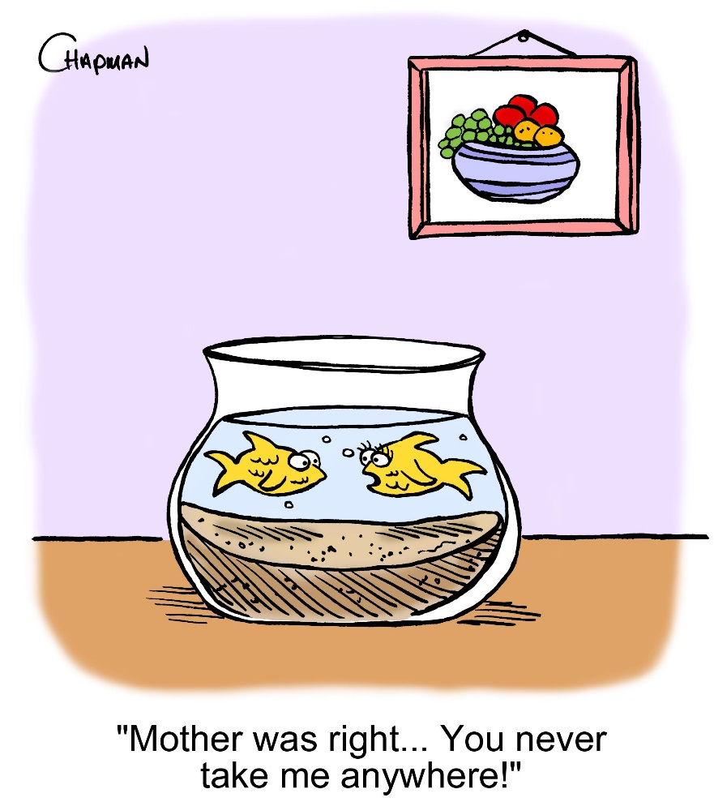
A recent college graduate girl’s marriage proposal comes from a handsome doctor from a distant friend of the father. The girl’s mother knows the humble background of boy’s family so she refuses to accept the proposal. Father says, the family background does not matter as long as the boy is well educated and is a good Ahmadi. Mother insists that she will never marry her daughter in a family of so poor background. What should father do?
Discussion III

Slide 16
  Option 1: Father should overrule and accept the proposal without the consent of the mother.
  Option 2: Father should try to convince the mother that it is a good proposal and we should accept it.
  Option 3: Father should agree with the mother.
  Option 4: Father should ask the daughter and if she agrees, then should try to convince mother but overrule if she still does not agree.

Slide 17
Guidance from KMIV
There is a bad tradition in our people that they do not like to give their daughters in marriage to a different caste nor they like to take any women from another. This shows a pride and arrogance which is totally against the commandments of Sharia. All human beings are created by God. During the time of marriage proposal, what should be evaluated is only if a person is righteous and possesses good moral qualities and if he or she is not involved in any such problem which can cause trouble later. And remember that Islam does not differentiate between any castes or nations. Its only righteousness which is a standard. Allah Ta’ala says, the best among you is he, who is the most righteous.
(Excerpt from Friday sermon, January 19, 2001)

Slide 18
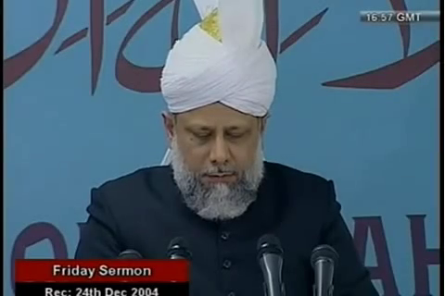
A Short Video Clip from Friday Sermon, Dec. 24, 2004

Slide 19
Translation of the Video
It is related by Abu Hatam (ra) that the Holy Prophet (saw) said that if a person brings a marriage proposal to you that you, and if you like his faithfulness and morals, then accept his proposal and if you don’t do so, chaos and disorder will ensue on earth. Someone wanted to ask a question but he repeated it three times that if a person brings a marriage proposal to you that you like his faithfulness and morals, then accept his proposal. So he [the Holy Prophet (saw)] pointed our attention that we should accept the marriage proposal of a person of faith. Even if he is financially weak, it is Allah’s promise that if he is steadfastness in faith, he will improve his financial condition. So when the marriage proposals for girls come along, we should not delay that much. Instead if we are satisfied on faithfulness, then we should accept the proposal. Similarly the Holy Prophet (saw) said for the men as well that don’t look at the worldly and surface appearance of the girl while deciding to marry. Don’t look at her status! Instead, look how righteous she is. So, Abu Hurairah (ra) relates that the Holy Prophet (saw) said that there could be four possible bases to marry a girl; due to her wealth, her family status, her beauty and charm or her religious character but you should prefer religious character. May God bless you and you marry a religious woman". By pointing to this direction, [the Holy Prophet (saw)] has drawn attention of the next generations to be religiously truthful and making home atmosphere peaceful. If the mother is righteous and faithful then generally the children will also be faithful. There is no wealth or any other source of peace better than the righteous and noble progeny. For a righteous person, only noble and righteous children can bring honor. So every Ahmadi should pay attention to this matter.

Slide 20
Where do we stand?
اپنے جائزے لیں -
Self-analyze yourself
Would you marry your daughter to a taxi driver if he makes enough to comfortably support your daughter?
Would you allow your son to marry an honest high school graduate rejecting a doctor’s proposal?
Would you be OK if your daughter marries a good Ahmadi boy from a different racial background?
Add the number of ’yes’ answers.
(Keep it to yourself... the “score” is for you!)

Slide 21
Combined Score
اپنے اندر پاک تبدیلیاں پیدا کریں -
Bring about pious changes in yourself
0
1-2
3
Try to align your thinking to true Islamic teachings and pray hard seeking knowledge and wisdom.
Continue to be strong in your faith and keep praying from God to help you overcome any vain reservations.
Stay strong in faith and inspire people around you with your ideas and thoughts.

Slide 22

Health Topic
Oral and Dental Health

Slide 23

Healthy mouth = Healthy body
Taking care of your teeth isn’t just about having a nice smile and pleasant breath. Recent research has found a number of links between Oral and Overall Health
Sugar-laden diet will contribute to tooth decay and gum problems
Smoking (cigarettes/cigars other tobacco) can cause gum disease, tooth decay and oral cancer
Drinking alcohol can contribute to oral problems indirectly by resulting in a dehydrated mouth, which can allow bacteria to run rampant
Changes in weight. For those who wear dentures, changes in body weight tend to affect the way dentures fit. To help maintain a healthy weight and fight tooth decay, the ADA advises people to eat a diet rich in high-fiber fruits and vegetables
Medication There are 200 to 400 medications, prescription or OTC that have the side effect of drying up saliva. Dry mouth is prone to gum disease and tooth decay, as well as bad breath.”

Slide 24
Conditions linked to oral health
Endocarditis is an infection of the inner lining of your heart (endocardium). It can occur when germs from your mouth and other parts of body travel by bloodstream and attach to damaged areas in your heart
Cardiovascular disease. Heart disease and stroke might be linked to the inflammation and infections that oral bacteria can cause
Pregnancy and birth Periodontitis has been linked to premature birth and low birth weight
Diabetes Gum disease appears to be more frequent and severe among people who have diabetes. Research also shows that people who have gum disease have a harder time controlling their blood sugar levels
HIV/AIDS. Oral problems, such as painful mucosal lesions, are common in people who have HIV/AIDS
Osteoporosis causes bones to become weak and brittle — may cause periodontal bone loss and tooth loss
Alzheimer’s disease. Tooth loss before age 35 might be a risk factor for Alzheimers
Sjogren’s syndrome — an immune system disorder that causes dry mouth and possibly oral disease

Slide 25
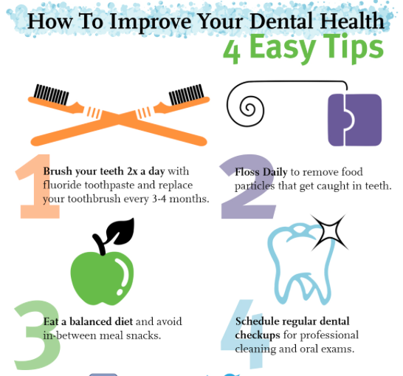
How can I protect my oral health?
Practice good oral hygiene every day
Brush your teeth at least twice a day
Floss daily
Eat a healthy diet and limit between-meal snacks
Replace your toothbrush every three to four months or sooner if bristles are frayed
Schedule regular dental checkups
Also, contact your dentist as soon as an oral health problem arises. Remember, taking care of your oral health is an investment in your overall health.

Slide 26
National Reminders
Four Priorities for 2016
At least 50% of Tajnid to attend monthly meetings where we discuss our Khalifa’s vision: “Save yourself and your families from a fire” in interactive discussions.
Help establish a culture of congregational Salat.
Help strengthen the love of Holy Quran.
More than 50% Tajnid to attend National Ijtima. The National Ijtema and Shura will take place in BRM on Sep 23-25, 2016. Please start planning now

Slide 27
Local Reminders
Local Reminders
Dua

